Slide 1

European Parliament Online
Riccardo Gobbato - Chiara Maggi
Pasquale Mocerino - Simone Scaccia

Slide 2

Project idea
A system ideally commissioned by the European Union. It empowers citizens from all EU membernations to actively participate in surveys, expressing their views on critical issues and proposing ideas for future referendums.
SYSTEM PROPERTIES
1. Submission to Citizens
2. Citizen-Proposed Referendums
3. Nation-Level Evaluation
4. Approval Criteria at the National Level
5. Outcome of National Referendums
6. European Referendums
7. Minimum Voting Threshold

Slide 3



Main components
The deployed components are grouped into services for specific nations and those that are available to all nations.
NATIONAL SERVICES
Web: implements the web interface, providing the main functionalities to the users
Broadcast: implements the broadcast and the consensus primitives
Rest: provide CRUD API to manage resource on the database
PostgreSQL: implements the persistence of the nation data
  STANDALONE SERVICES
  RabbitMQ broker: provide the exchange of messages between nations by implementing a queue system.

Slide 4

Spring Boot
All the services are Spring-Boot project.
Spring Boot is an open-source framework for building Java applications, designed to simplify development with minimal configuration.
Dependecies of the services:
Web service: Thymeleaf, Spring Boot Starter Web, Spring DevTools, and Spring Boot Starter Test:
Rest service: Spring Data JPA, Spring Boot Starter Web, Spring DevTools, Spring Boot Starter Test, and PostgreSQL.
Broadcast service: Spring Boot Starter AMQP, Spring Boot Starter Web, Spring DevTools, Spring Boot Starter Test, Spring Rabbit Test, and Google Gson.

Slide 5

Docker
We have implemented a docker-compose for each nation, plus a docker-compose for RabbitMQ.
The RabbitMQ Management Container allows to manage RabbitMQ through a web interface. The container is connected to 3 custom networks, which we have used to facilitate communication between RabbitMQ and other containers in different networks.
For each service (in every nation) there is a docker file to allow the creation of the jar file and the containe file and the container. There are two main parts:
  Build Stage: runs "mvn clean package" to build the Java application using Maven.
  Package Stage: sets the entry point for the Docker container to run the Java application using the JAR file (’app-1.0.0.jar’).This Dockerfile separates the build process from the final runtime image, resulting in a smaller runtime image that only contains the necessary JRE and the application JAR file.

Slide 6
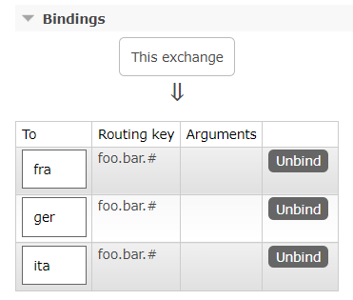
Rabbit MQ
This node is needed for making asynchronous communication possible between the servers in charge of dispatching the messages between the organization workers.
Each nation establishes its own queue on this broker and designates a routing key.
When a nation desires to send a broadcast message, it selects a routing key that matches all the nations, allowing them to receive the message in their respective queues.
Once the message has been read, it will be automatically removed from the queue.

Slide 7

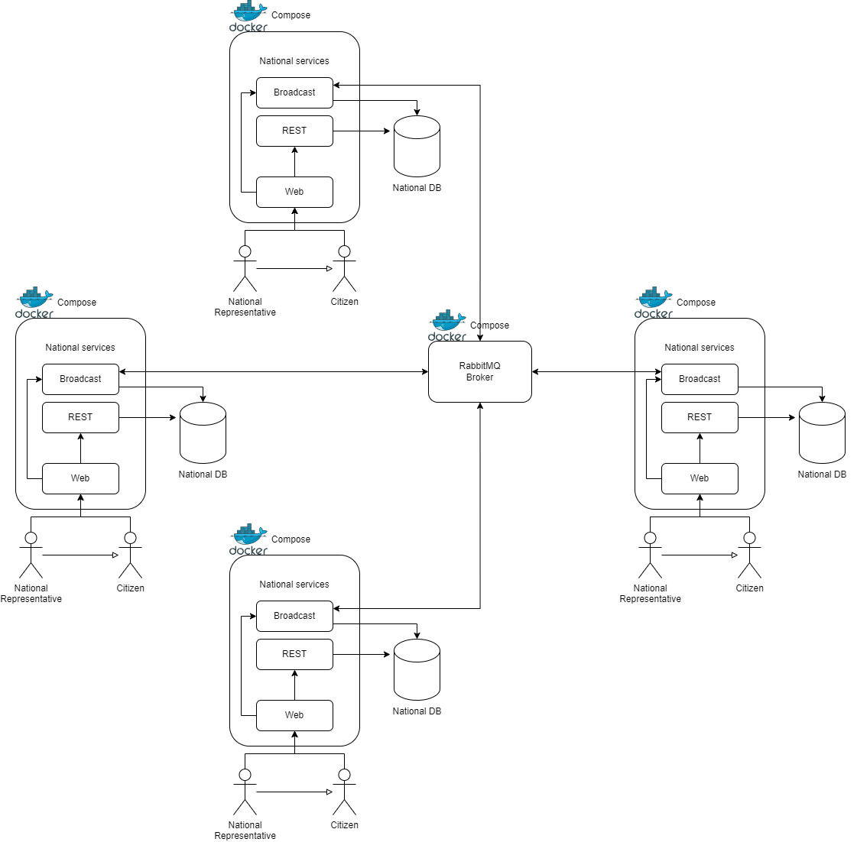

Slide 8

User stories
8

Slide 9
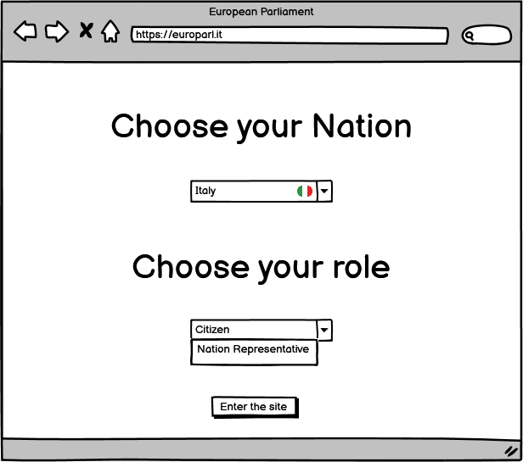
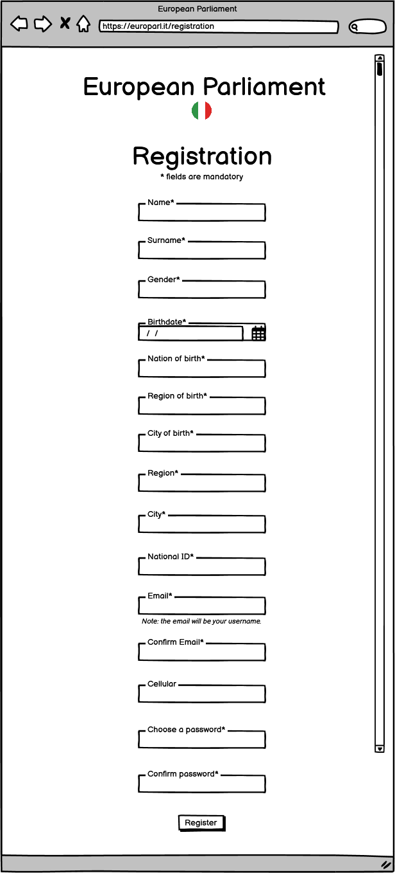

Mockup Balsamiq
As a citizen, I want to select the nation related to my legal citizenship, so that I can navigate in the page hosted by that nation.
As a citizen, I want to select the nation related to my legal citizenship, so that I can navigate in the page hosted by that nation.

Slide 10
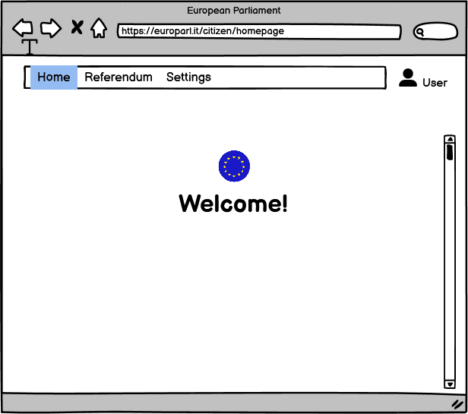
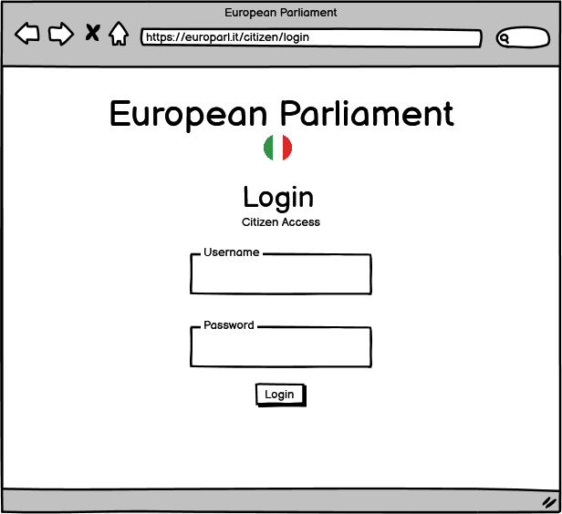
Mockup Balsamiq
As a citizen, I want to authenticate myself in the the page hosted by the nation related to my legal citizenship, so that I can access the national service
As a citizen, I want to have a personal area displaying the possible services, so that I can choose a service (referendum and information)

Slide 11
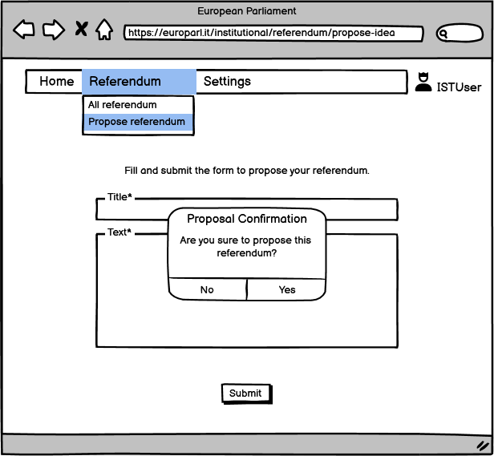
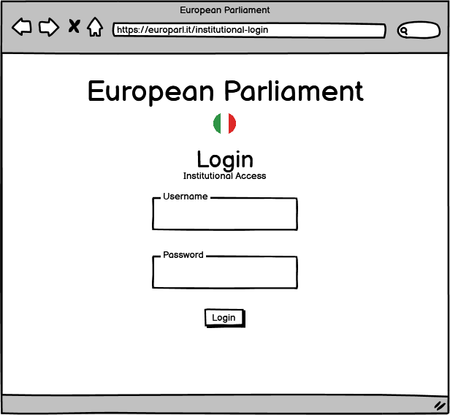
Mockup Balsamiq
As a nation representative, I want to propose an idea for an European Referendum to other European nations, so that it can be proposed to all European citizens.
As a nation representative, I want to authenticate myself in the context of my nation, so that I can manage the national service.

Slide 12
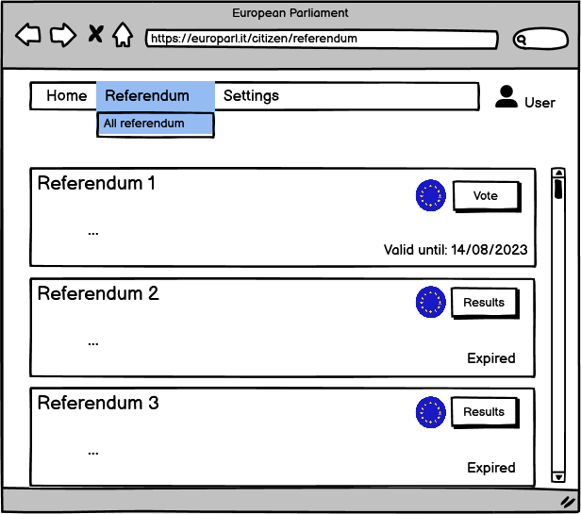
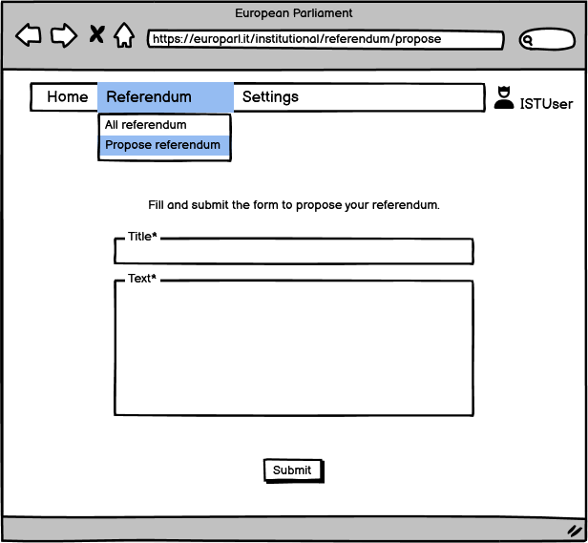
Mockup Balsamiq
As a nation representative, I want to declare a new national referendum, constituted by one question with "Yes" or "No" answer, so that I can obtain votes from citizens of my nation
As a citizen, I want to see the list of all referendums declared by my nation, so that I can vote.

Slide 13
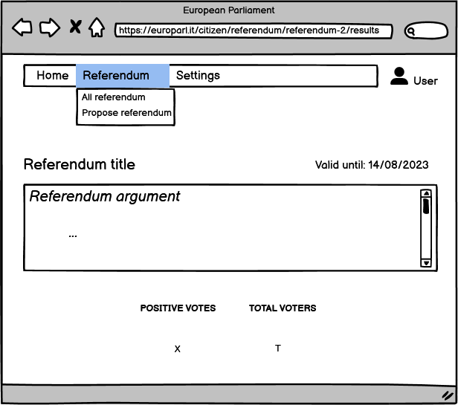
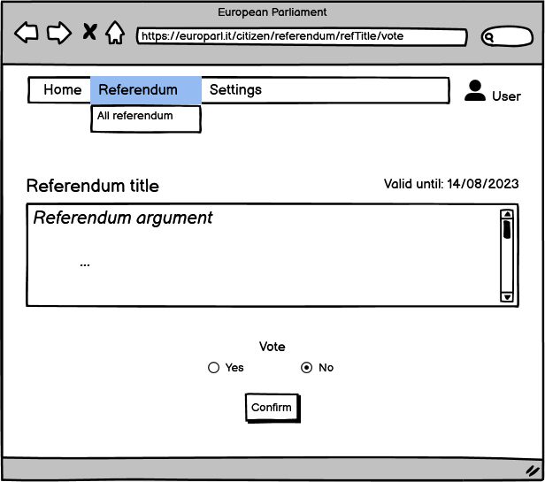
Mockup Balsamiq
As a nation representative, I want to see the final result of the voting process related to an European referendum, so that I can apply it if it has been approved by European citizens
As a citizen, I want to see the results of a referendum declared by my nation, so that I can know the outcome
As a citizen, I want to vote in a referendum declared by my nation, so that I can express my opinion

Slide 14
Workflow organization

Slide 15
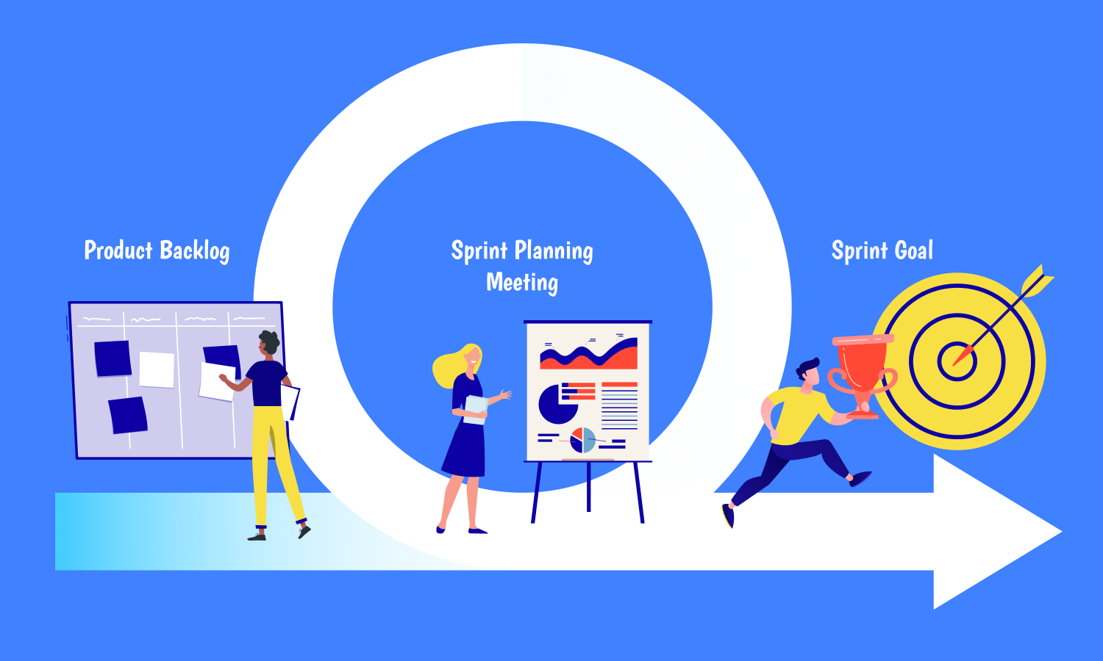
Sprint planning
Create a product backlog, which included a list of features and requirements
Prioritize the items in the backlog, based on their value to the end-users and the organization.
Select a set of items from the product backlog and created a sprint backlog, which included a list of tasks and objectives for the sprint.

Slide 16
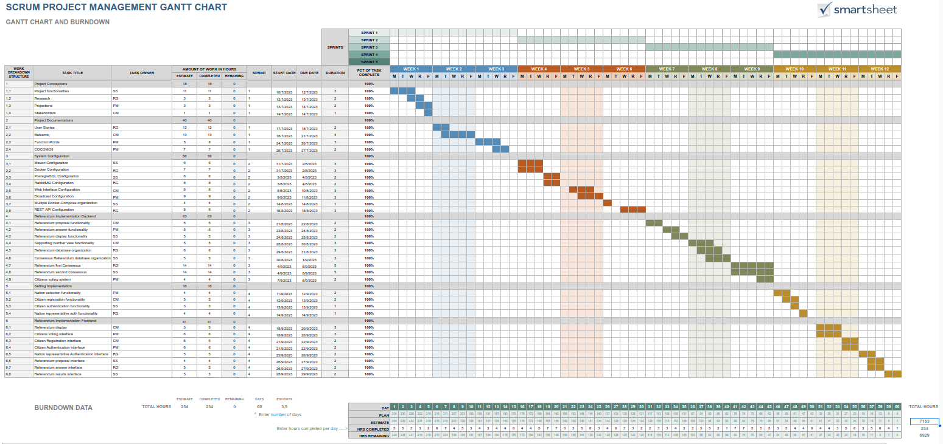

Slide 17
Product backlog

Slide 18
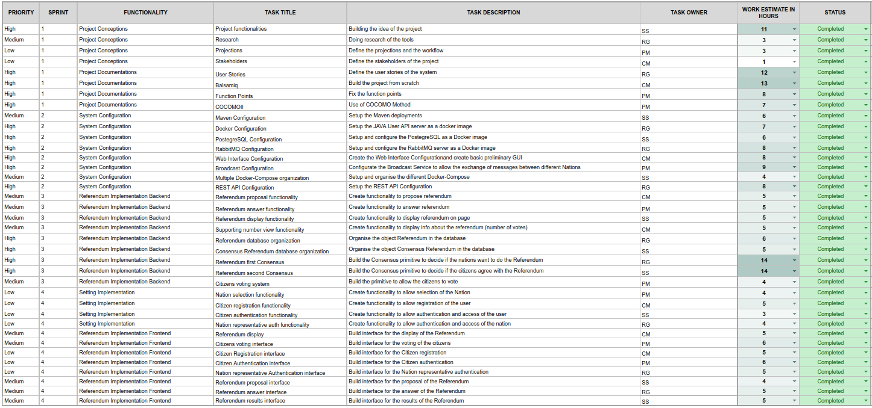

Slide 19
Function points

Slide 20
Function points
Interaction with the user
Citizen web interface
A citizen can login on the interface by submitting username and password, so we have an EI with 1 FTR and 2 DET:
  0-1 FTR and 1-4 DET EI => 3 FP
A citizen can register by submitting all citizen fields, so we have an EI with 1 FTR and 14 DET:
  0-1 FTR and 5-15 DET EI => 3 FP
A citizen can get the referendum list, with all fields for each referendum, so we have an EQ with 1 FTR and 13*(number of referendum) DET EQ:
  0-1 FTR and 20+ DET EQ => 4 FP
A citizen can access to the voting page of a single referendum, getting the details of a single referendum and submitting the vote to that specific referendum:
  EQ with 1 FTR and 13 DET. 0-1 FTR and 6-19 DET EQ => 3 FP
  EI with 1 FTR and 1 DET. 0-1 FTR and 1-4 DET EI => 3 FP

Slide 21
Function points
Interaction with the user
Representative web interface
A national representative can login on the inteface by submitting username and password, so we have an EI with 1 FTR and 2 DET:
  0-1 FTR and 1-4 DET EI => 3 FP
A national representative can publish a referendum by submitting title and text, so we have an EI with 1 FTR and 2 DET:
  0-1 FTR and 1-4 DET EI => 3 FP
Finally, a national representative get the referendum list, with all fields for each referendum, so we have an EQ with 1 FTR and 13*(number of referendum) DET EQ:
  0-1 FTR and 20+ DET EQ => 4 FP
Hence, the cost of the interaction with the user is the following one:
Cost(User) = Cost(Citizen web interface) + Cost(Representative web interface) = (16 FP) + (10 FP) = 26 FP

Slide 22
Function points
INTERACTION WITH RABBITMQ
The application receives a referendum proposal from RabbitMQ Broker, so we have an EI with 1 FTR and 13 DET.
  0-1 FTR and 5-15 DET EI => 3 FP
When proposing a referendum, the application sends a referendum proposal to other nations, so we have an EQ with 1 FTR and 13 DET.
  0-1 FTR and 6-19 DET EQ => 3 FP
When receiving a referendum proposal, the application sends a response for the first consensus, so we have an EO with 1 FTR and 8 DET.
  0-1 FTR and 6-19 DET EO => 4 FP
The application receives a response during first consensus execution, so we have an EI with 1 FTR and 8 DET.
  0-1 FTR and 5-15 DET EI => 3 FP
After receiving a referendum result from the voting process of citizens, the application sends this result to other nations, so we have an EO with 1 FTR and 8 DET.
  0-1 FTR and 6-19 DET EO => 4 FP
The application receives a referendum result from another nation, so we have an EI with 1 FTR and 8 DET.
  0-1 FTR and 5-15 DET EI => 3 FP
Cost(Other applications) = 20 FP

Slide 23
Function points
TOTAL COST
CitizenUser table has 13 mandatory fields and 1 optional field, InstUser table has 13 mandatory fields (representative ID instead of national ID) and 1 optional field (cellular), Referendum table has 13 fields and ReferendumConsensus table has 8 fields. So, we can consider the DB as a single ILF with 4 RET of 1-19 DET each one, since it can be accessed through the REST API internal component. For this ILF, we have 7 FP. This is the contribution related to the ILF of our application.
Cost(DB) = 7 FP
Total cost = Cost(DB) + Cost(User) + Cost(Other applications) = (7 FP) + (26 FP) + (20 FP) = 53 FP
HTML/JS: Cost(User) = 26 FP
JAVA: Cost(DB) + Cost(Other applications) = 27 FP

Slide 24
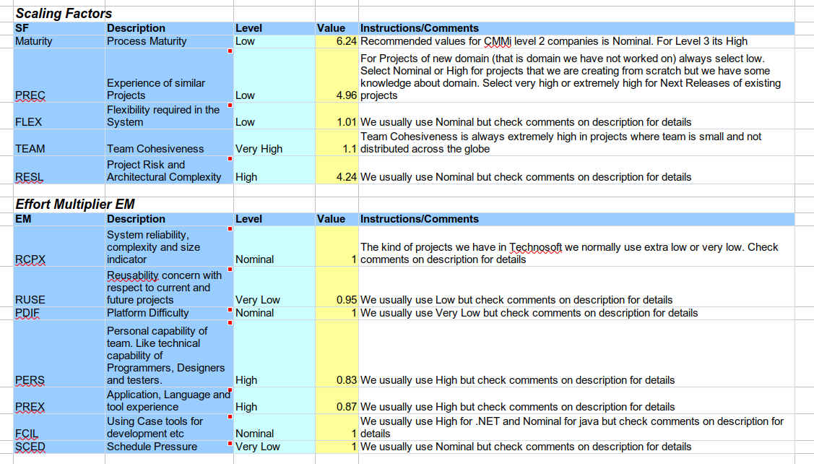
COCOMO II

Slide 25
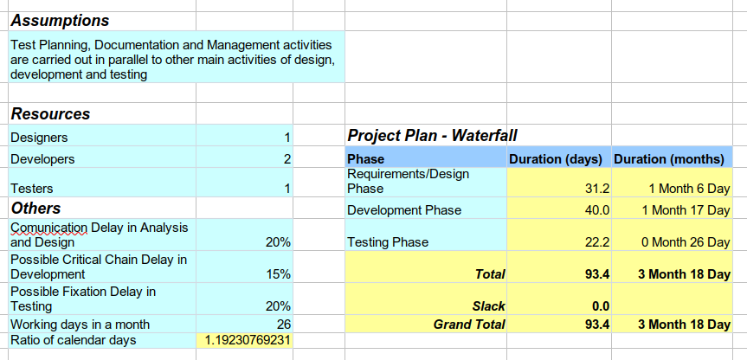
Cocomo ii
HTML/JS: 26 FP
1222 SLOC
JAVA: 27 FP
1431 SLOC

Slide 26

DEMO LIVE
https://github.com/RicGobs/EPO-European-Parliament-Online

Slide 27
Building a Distributed System
Processes: The system represents different nations as processes. The parameter N is used to indicate the potential for any number of processes, and scalability is considered.
Timing Assumptions: Asynchronous communication is handled by incorporating strategic timeouts, introducing partial synchrony to set bounds on response times and alleviate consensus challenges.
Clock Synchronization: The system relies on External Synchronization using frameworks like Spring Boot and UTC to ensure consistent timekeeping.
Failure Detector: While implementing a failure detector using REST API communication can enhance consensus mechanisms, the assumption is made that all processes are correct.

Slide 28
Building a Distributed System
(continues)
Link Abstractions: Reliable message delivery is ensured using RabbitMQ, which offers perfect point-to-point communication (reliable delivery, no duplication, and no creation).
Flooding Consensus with a single RabbitMQ Broker:
Using 1 Broker for the broadcast communication, UniformReliable Broadcast is ensured. URB ensures uniform agreement on the values decided, and even in the event of crashes, it still only requires n² messages (squared) instead of n³ (cubed). This makes it a more efficient option for achieving consensus.

Slide 29
Building a Distributed System
(continues)
Flooding Consensus with multiple RabbitMQ Broker:
Using multiple brokers for the broadcast communication,Best Effort Broadcast is ensured. With this property, flooding consensus is not suitable due to the risk of disagreements in case of process crashes. It comes at the disadvantage of requiring n³ messages in some cases.

Slide 30

Performance Evaluation (1)
Elapsed time (worst case)
Timeout for the last three actions
Total elapsed time
  Time to publish the Referendum: about 0 s;
  Time to conclude the first consensus: t.
  Time to vote by citizens: x.
  Time to conclude the second consensus: t.
T = x + 2 · t

Slide 31
Performance evaluation (2)
Message weight
  Fields: 4 string, 2 boolean and 2 integer:
    String title (max 50 characters): 50 · 2 Bytes
    Integer status: 4 Bytes
    String nationSourceAnswer: 3 · 2 Bytes
    Boolean answer: 2 Bytes
    String proposals: 4n + (n-1) Bytes
    Integer round: 4 Bytes
    Boolean isDecision: 2 Bytes
    String dateStartConsensusProposal (dd/MM/yyyy HH:mm:ss): 19 · 2 Bytes
    Overhead added by rabbit: 736 Bytes
  Total W = 892 Byte + 4n + (n-1) Byte.
Number of messages
  z: number of messages based on the consensus primitive:
    flooding consensus with No failures: 2 · n² messages
    flooding consensus with n − 1 failures: n³ messages
    flooding uniform consensus: n³ messages
  Total messages M = n + 2 · z
    n: number of messages for sharing the Referendum

Slide 32
Performance evaluation (3)
Throughput per Referendum
  (Message weight · Number of messages)/ Total elapsed time
  W · M / T bytes/seconds

Slide 33
Performance evaluation (4)
Database utilization per Referendum
  ConsensusReferendum:
    Integer status: 2 Byte
    ConsensusReferendumId id:
      String title (max 50 characters): 50 · 2 Bytes
      String dateStartConsensusProposal (dd/MM/yyyy HH:mm:ss): 19 · 2 Bytes
    String correct: 3n + (n-1) Bytes
    Boolean decision: 2 Bytes
    Integer round: 4 Byte String proposals: 4n + (n-1) Bytes
    String receivedFrom: 3n + (n-1) Bytes
    So, for a total of 146 Bytes + 10n + 3(n-1) Bytes.
    Referendum
    ReferendumId id
      String title (max 50 characters): 50 · 2 Bytes
      String dateStartConsensusProposal
      (dd/MM/yyyy HH:mm:ss): 19 · 2 Bytes
    Integer status: 4 Bytes
    Integer votesTrue: 4 Bytes
    Integer votesFalse: 4 Bytes
    Integer population: 4 Bytes
    String argument: max 1 MegaByte
    String nationCreator: 3 · 2 Bytes
    String dateEndConsensusProposal: 19 · 2 Bytes
    String dateEndResult: 19 · 2 Bytes
    String dateEndConsensusResult: 19 · 2 Bytes
    So, for a total of 274 Bytes + 1 Megabyte.
The total utilization per Referendum is 420 Bytes + 1 Megabyte + 10n + 3(n-1) Bytes

Slide 34

Future improvements
So, a more complete list of future improvements is the following one:
Security measures implementation (verification and validation)
Removal of no failure assumption with failure detector implementation
Removal of SPoF with the use of multiple RabbitMQ brokers
Implementation of Byzantine tolerant protocols
Another important improvement is to design ad-hoc solutions in order to better cope with some undetachable context-related problems:
Data partition and heterogeneity
Unpredictable latencies

